Slide 1
INSTAGARM USER ANALYTICS PROJECT

Slide 2
PROJECT DESCRIPTION:-
The project is mainly designed to develop a system for analyzing meaningful insights from Instagram user data. The system will gather relevant information from Instagram profiles, posts, and engagement metrics to provide valuable analytics for individuals, businesses, or mentors.
I successfully collected a comprehensive dataset of Instagram user information, including profiles, posts, likes, comments, and follower data. User creation date.This involved handling large volumes of data and preprocessing it to ensure its suitability for analysis.
This understanding can be applied to optimize content strategies, posting schedules, and audience targeting for improved user engagement.
We can able to calculate and visualize key engagement metrics such as likes, comments, follows, hash tags and shares for individual posts and overall account. We can also able to identify trends and patterns in user section. We can analyse the types of content (photos, videos, stories, etc.) that generate the highest engagement and understand the impact of captions, hash tags, and filters on user interaction.

Slide 3
Approach
In the Instagram User Analytics project, our approach was to develop a user-centric analytics solution for mentors. We began by thoroughly understanding the requirements and needs of began which helped us define the key features and metrics to focus on.
Throughout the development process, we paid close attention to data handling , performance optimization, and user experience.
Analysing user activity patterns revealed optimal posting times, peak engagement periods, and the user who have most followers , most likes, most photos liked. This information is valuable for scheduling posts strategically and maximizing reach and interaction with the target audience.
Also, By identifying top users based on follower count, engagement rates we gained insights into successful users strategies. Analyzing their approaches and content patterns provides guidance for user marketing campaigns.
. Ethical Data Handling: Throughout the project, I maintained a strong emphasis on ethical data handling ensuring data consistency.This experience enhanced my understanding of data ethics in the context of social media analytics

Slide 4
TECH-STACK USED
software used-
MYSQL 8.0- SQL queries are used to retrived manipulation, and analysis of different kind of data.

Slide 5
INSIGHTS:-
User Segmentation: Through user segmentation based on attributes such as name, user creation date, we infer that different user groups exhibit preferences on Instagram. This knowledge can help marketing strategies to target specific user segments effectively.
Engagement Analysis: By analyzing engagement metrics like likes, comments, and shares, we gained insights into the types of content that generate higher engagement rates. This understanding can guide content creators and marketers in creating more engaging and impactful posts.
User Activity Patterns: Analyzing user activity patterns revealed optimal posting times, peak engagement periods, and post lifespan. This information is valuable for scheduling posts strategically and maximizing reach and interaction with the target audience.

Slide 6
INSIGHTS
Content Analysis: Analyzing the impact of captions, hashtags, and filters on user interaction revealed the importance of compelling captions, relevant hashtags, and visually appealing content. These elements contribute to higher engagement rates and better audience reception.
Growth and Follower Analysis: Tracking follower growth retention helped identify effective strategies for attracting and maintaining followers. Identifying influential followers enables leveraging their impact on engagement.
Overall, this project provided valuable insights into user behavior, engagement patterns, and effective strategies on Instagram. The knowledge gained helps businesses, influencers, and marketers optimize their content, timing, and overall Instagram strategies to enhance user engagement and reach.

Slide 7
RESULT:
Working on this project has provided me with valuable hands-on experience in data collection, preprocessing, analysis, and visualization in the context of Instagram user analytics. It has improved my proficiency in working with multiple tables, particularly in using function for data manipulation .
Furthermore, this project has deepened my knowledge of social media analytics and the factors that contribute to user engagement and success on Instagram. It has expanded my skills in deriving actionable insights from data and translating them into effective strategies.
Overall, this project has enhanced my analytical capabilities, data handling skills, and understanding of user behavior in the realm of social media. It has equipped me with valuable knowledge and practical experience that can be applied to similar projects and real-world scenarios involving user analytics and engagement optimization
This understanding can be applied to optimize content strategies, posting schedules, and audience targeting for improved user engagement.

Slide 8
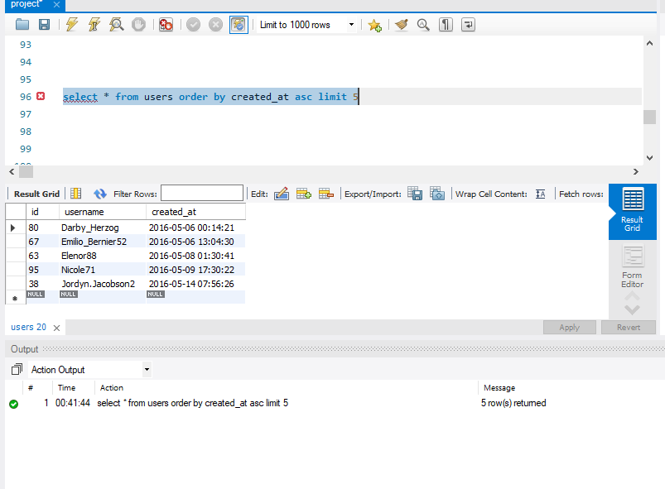
Detailed report of query used in this project to launch campaign from marketing team: 1.
To find and reward most Most Loyal Users i.e People who have been using the platform for the longest time.
Here is the snap of query:

Slide 9
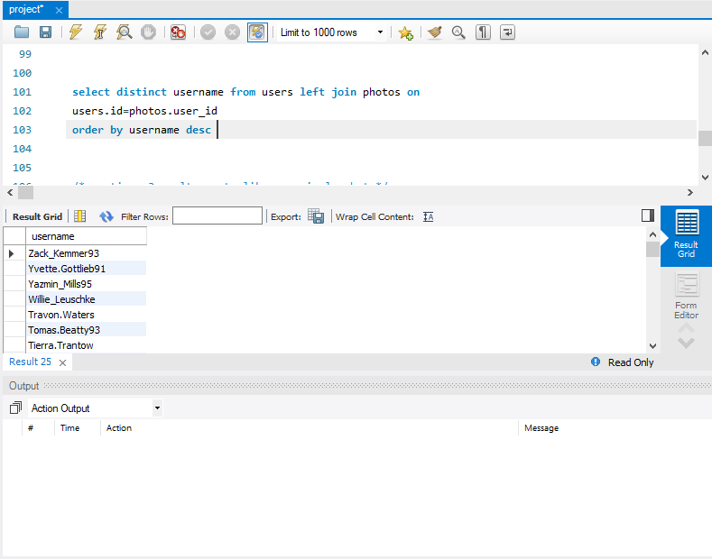
2.To Remind Inactive Users to Start Posting: Your Task: Find the users who have never posted a single photo on Instagram Here is the snap

Slide 10
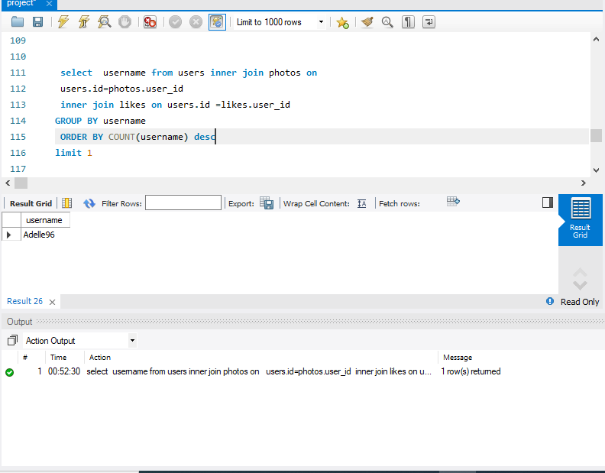
3. Declaring Contest Winner: The team started a contest and the user who gets the most likes on a single photo will win the contest now they wish to declare the winner. Here is the snap.

Slide 11
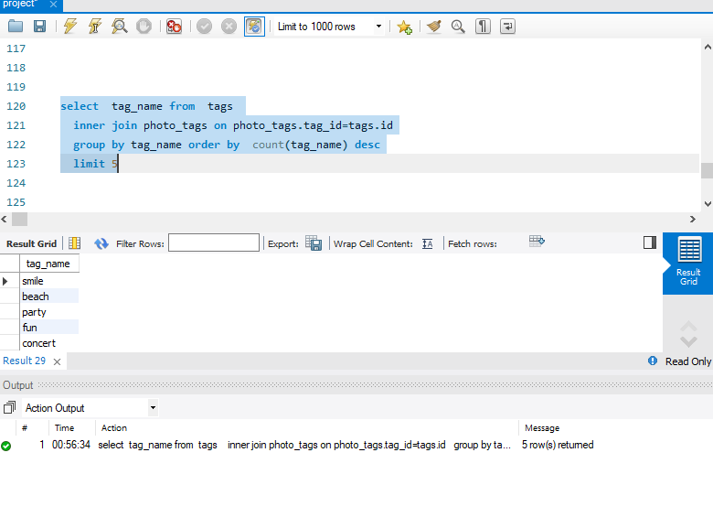
4. Hashtag Researching: A partner brand wants to know, which hashtags to use in the post to reach the most people on the platform. Here is the snap

Slide 12
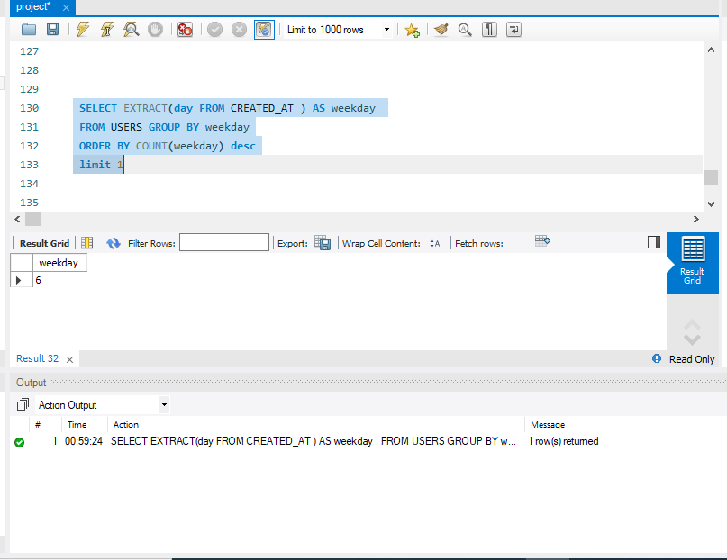
5. Launch AD Campaign: The team wants to know, which day would be the best day to launch ADs. Here is the snap

Slide 13
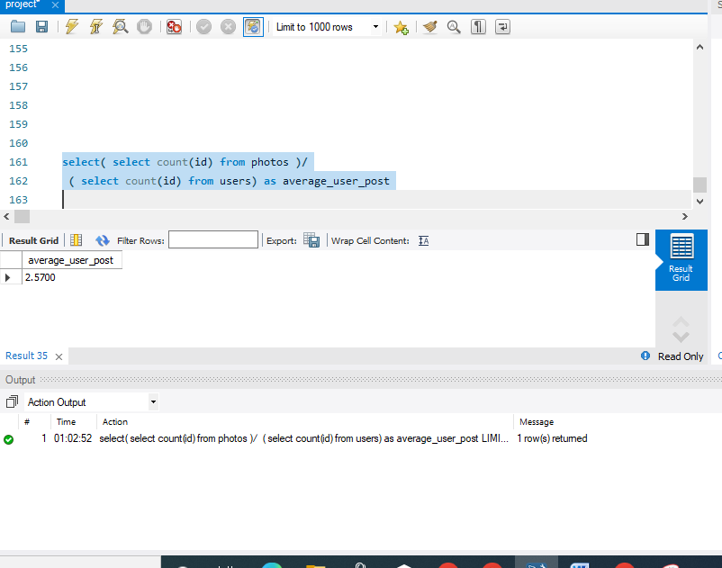
B. ) 1.Investor Metrics: Our investors want to know if Instagram is performing well and is not becoming redundant like Facebook, they want to assess the app on the following groundsUser Engagement: Are users still as active and post on Instagram or they are making fewer posts.Here is the snap.

Slide 14
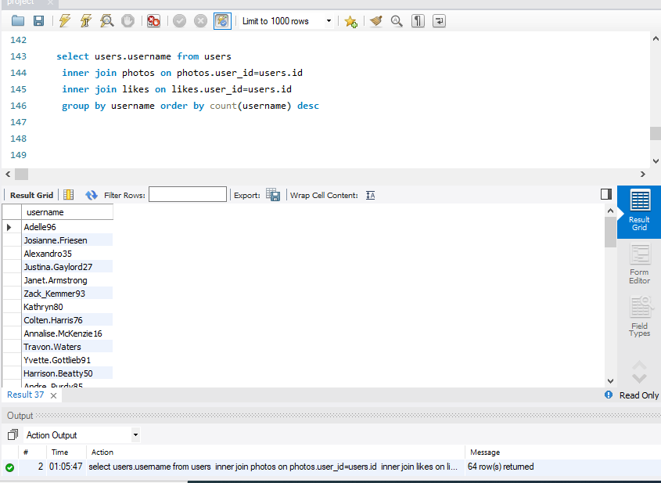
B2. Bots & Fake Accounts: The investors want to know if the platform is crowded with fake and dummy accounts Here is the snap.

Slide 15
Here is the link provided of this file.
https://docs.google.com/presentation/d/18nTzZ8QmrnScTMBwGHi4i2wvJZvZBai1/edit?usp=sharing&ouid=102798538525957876779&rtpof=true&sd=true
THANKS
https://docs.google.com/presentation/d/18nTzZ8QmrnScTMBwGHi4i2wvJZvZBai1/edit?usp=sharing&ouid=102798538525957876779&rtpof=true&sd=true

